Slide 1
Observing the Free-Boundary Nature of American Options
John Lee
3/20/2024

Slide 2
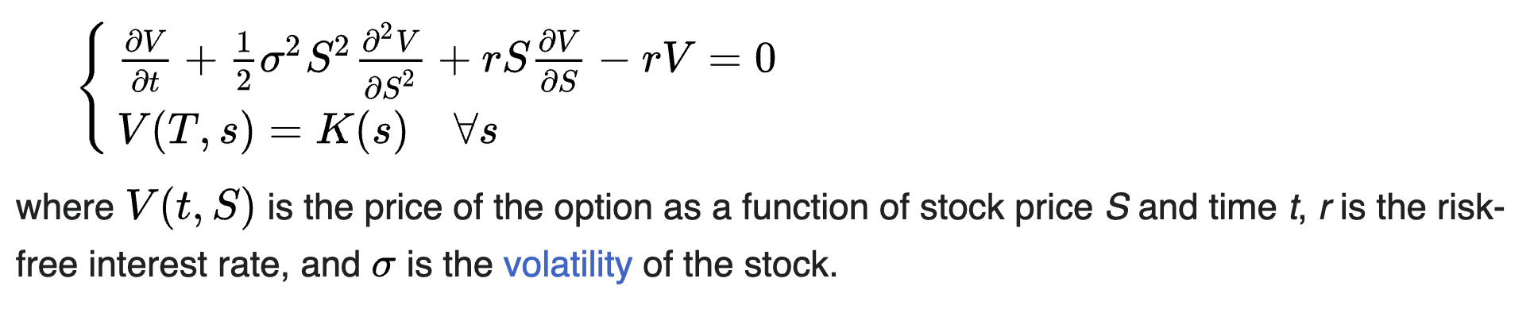
What are options?
Call/Put Options
Contract that gives you the right to buy/sell an underlying asset (ex. Stocks) at a strike price K. Has an expiration time T.
Priced by time value + intrinsic value
Black Scholes Model (European Options)

Slide 3
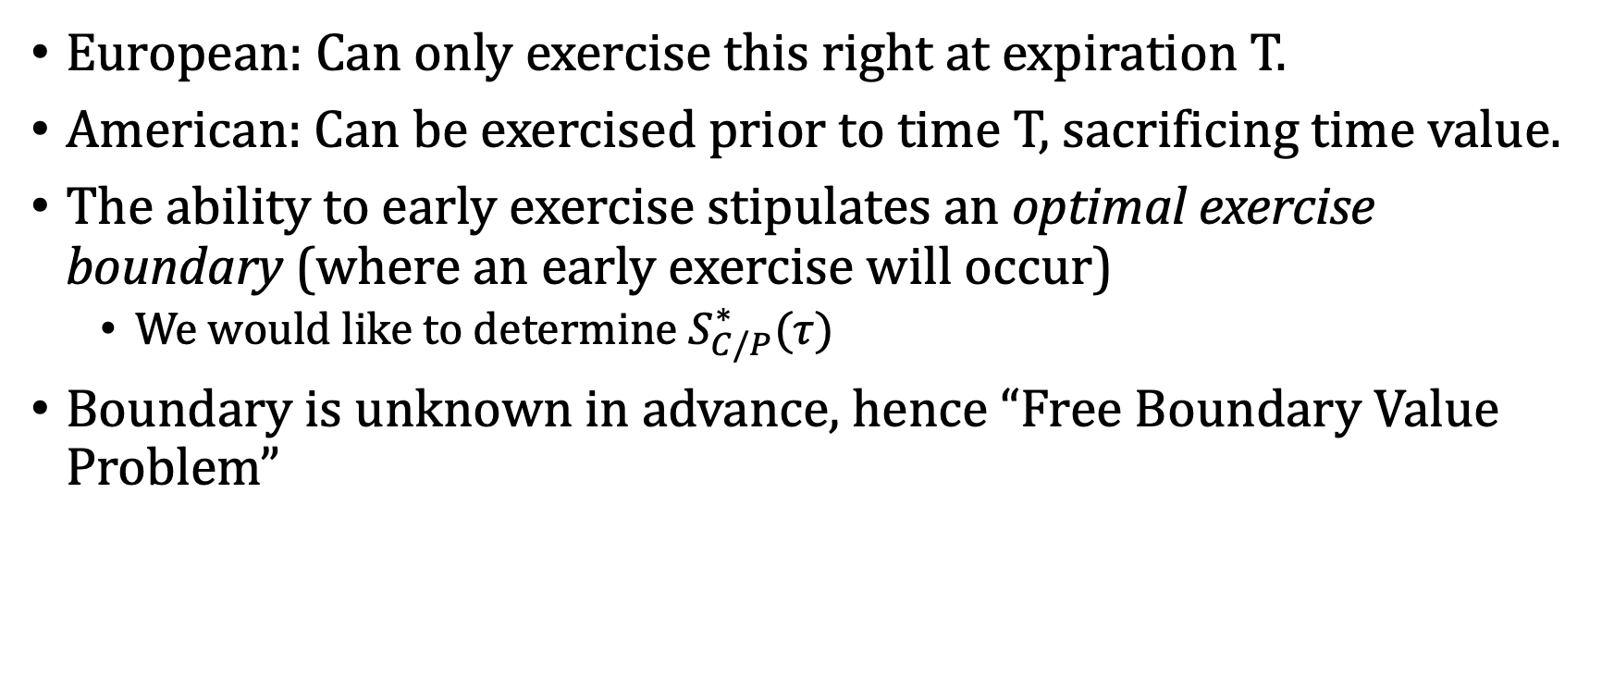
American vs. European Options
European: Can only exercise this right at expiration T.
American: Can be exercised prior to time T, sacrificing time value.
The ability to early exercise stipulates an optimal exercise boundary (where an early exercise will occur)
We would like to determine $S_{C/P}^{∗}(τ)$
Boundary is unknown in advance, hence “Free Boundary Value Problem”

Slide 4
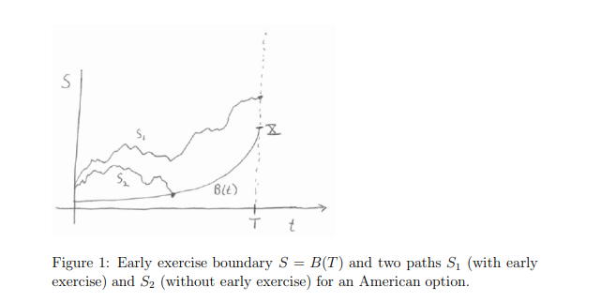
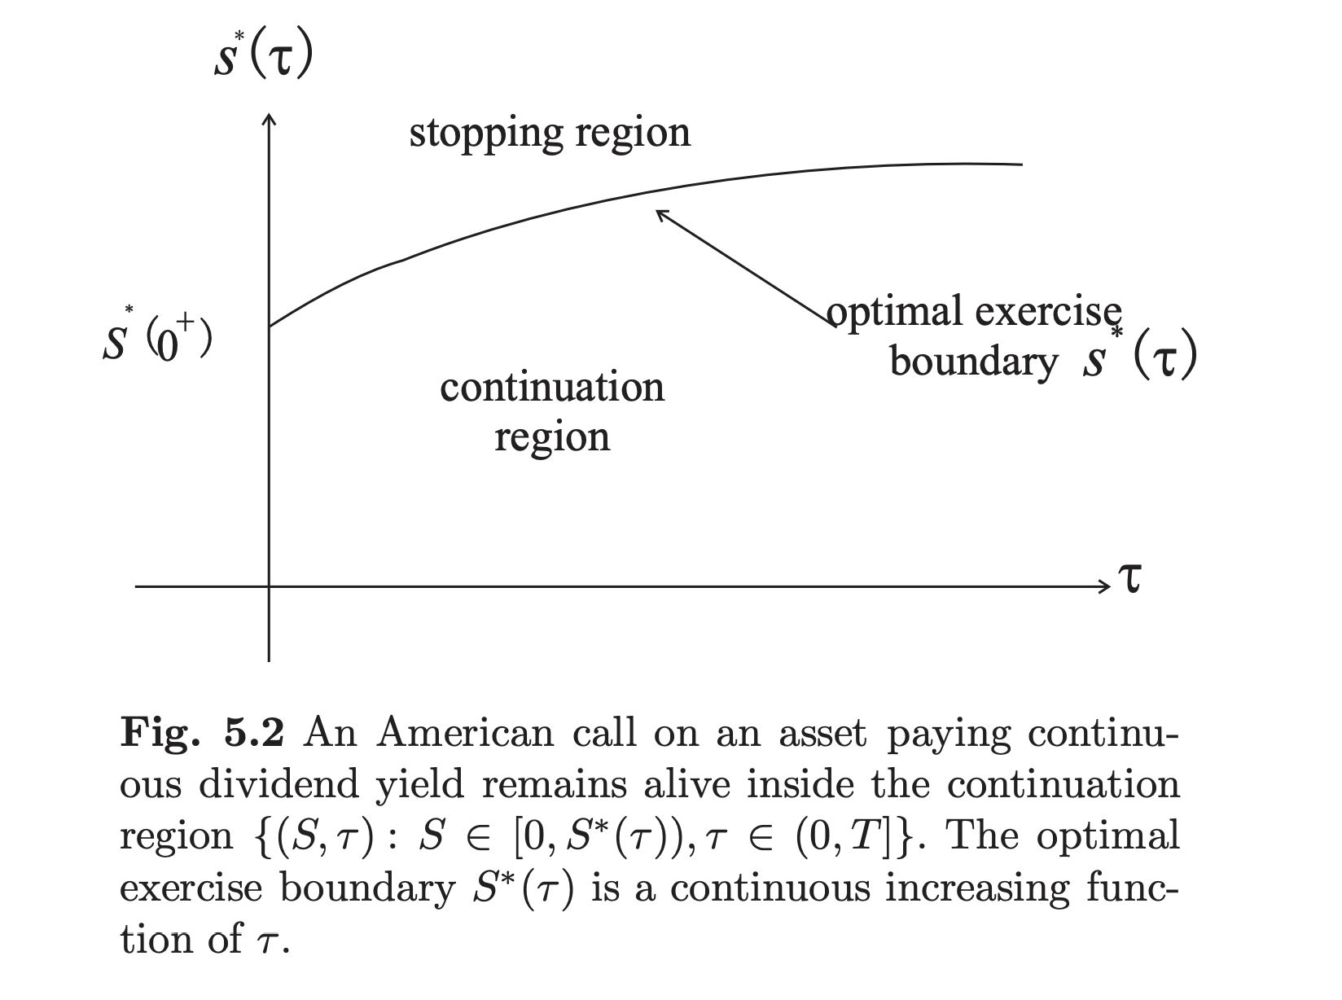
Put Option
Call Option

Slide 5
Cases for Early Exercise
American Call Options
Only valid for stock with dividend (both discrete and continuous)
Underlying Spot price P >> Strike Price K
American Put Options
As time value decreases (t → T), then sacrificing time value will become insignificant compared to investing the immediate profit in a “riskless” asset and collecting interest.
Optimal boundary always exists for risk-free rate > 0

Slide 6
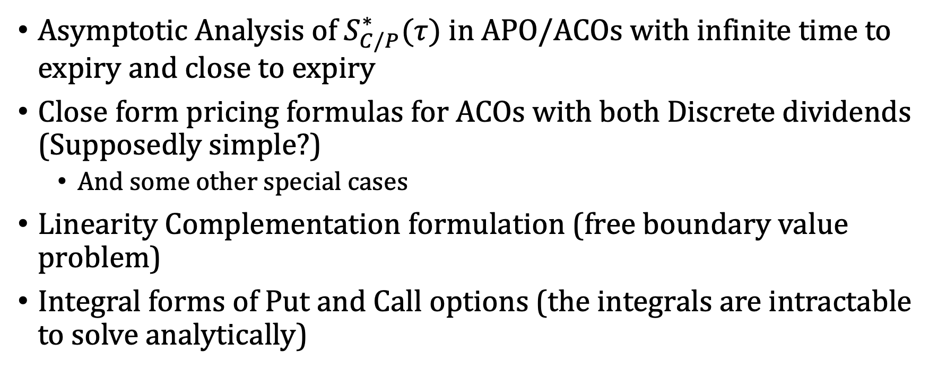
Project Work
Asymptotic Analysis of $S_{C/P}^{∗}(τ)$ in APO/ACOs with infinite time to expiry and close to expiry
Close form pricing formulas for ACOs with both Discrete dividends (Supposedly simple?)
And some other special cases
Linearity Complementation formulation (free boundary value problem)
Integral forms of Put and Call options (the integrals are intractable to solve analytically)

